Slide 1

Monitoring your back-end
for speed
and profit
Experiences in optimising
shared hosting at the BBC
http://joind.in/4964
Andy ‘Bob’ Brockhurst
Principal Engineer, BBC Frameworks

Slide 2
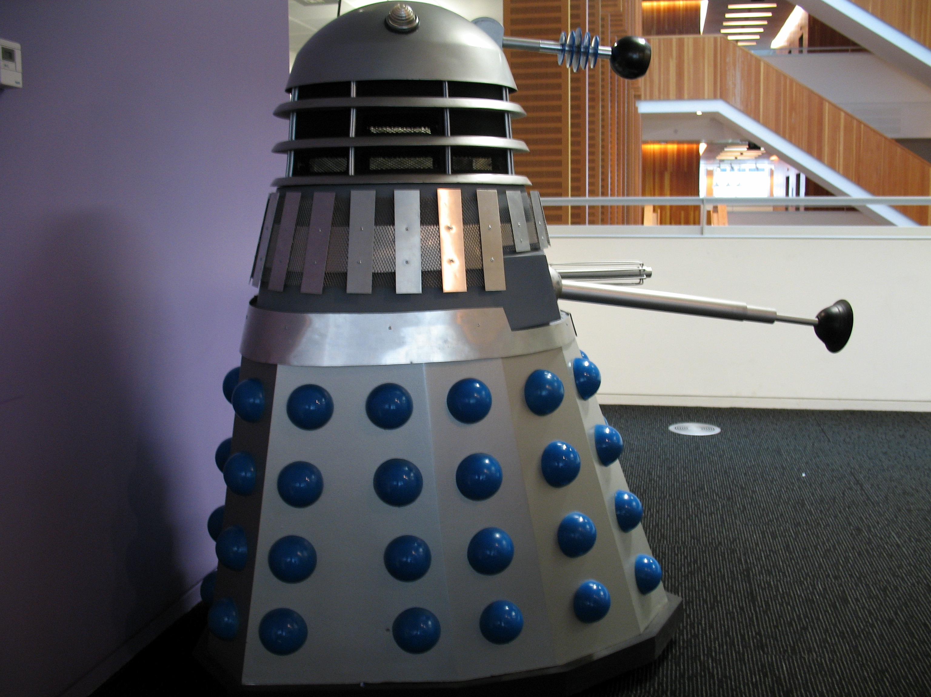
Introduction
The Team
LAMP (without the M)
Tomcat Java Service Layer
Zend Framework..
...customised a.k.a PAL
BBC Micro
Spectrum
Barlesque

Slide 3
How the BBC works
One domain^{[1]}
Two technology stacks^{[2]}
Cert’s and SSL
ProxyPass’
Apps are a TLD
360+ apps
Everyone shares everything^{[3]}
^{[1]} Okay there are several but they are all really the same one.
^{[2]} Okay, three if you are going to be picky.
^{[3]} Yes really, everything!

Slide 4
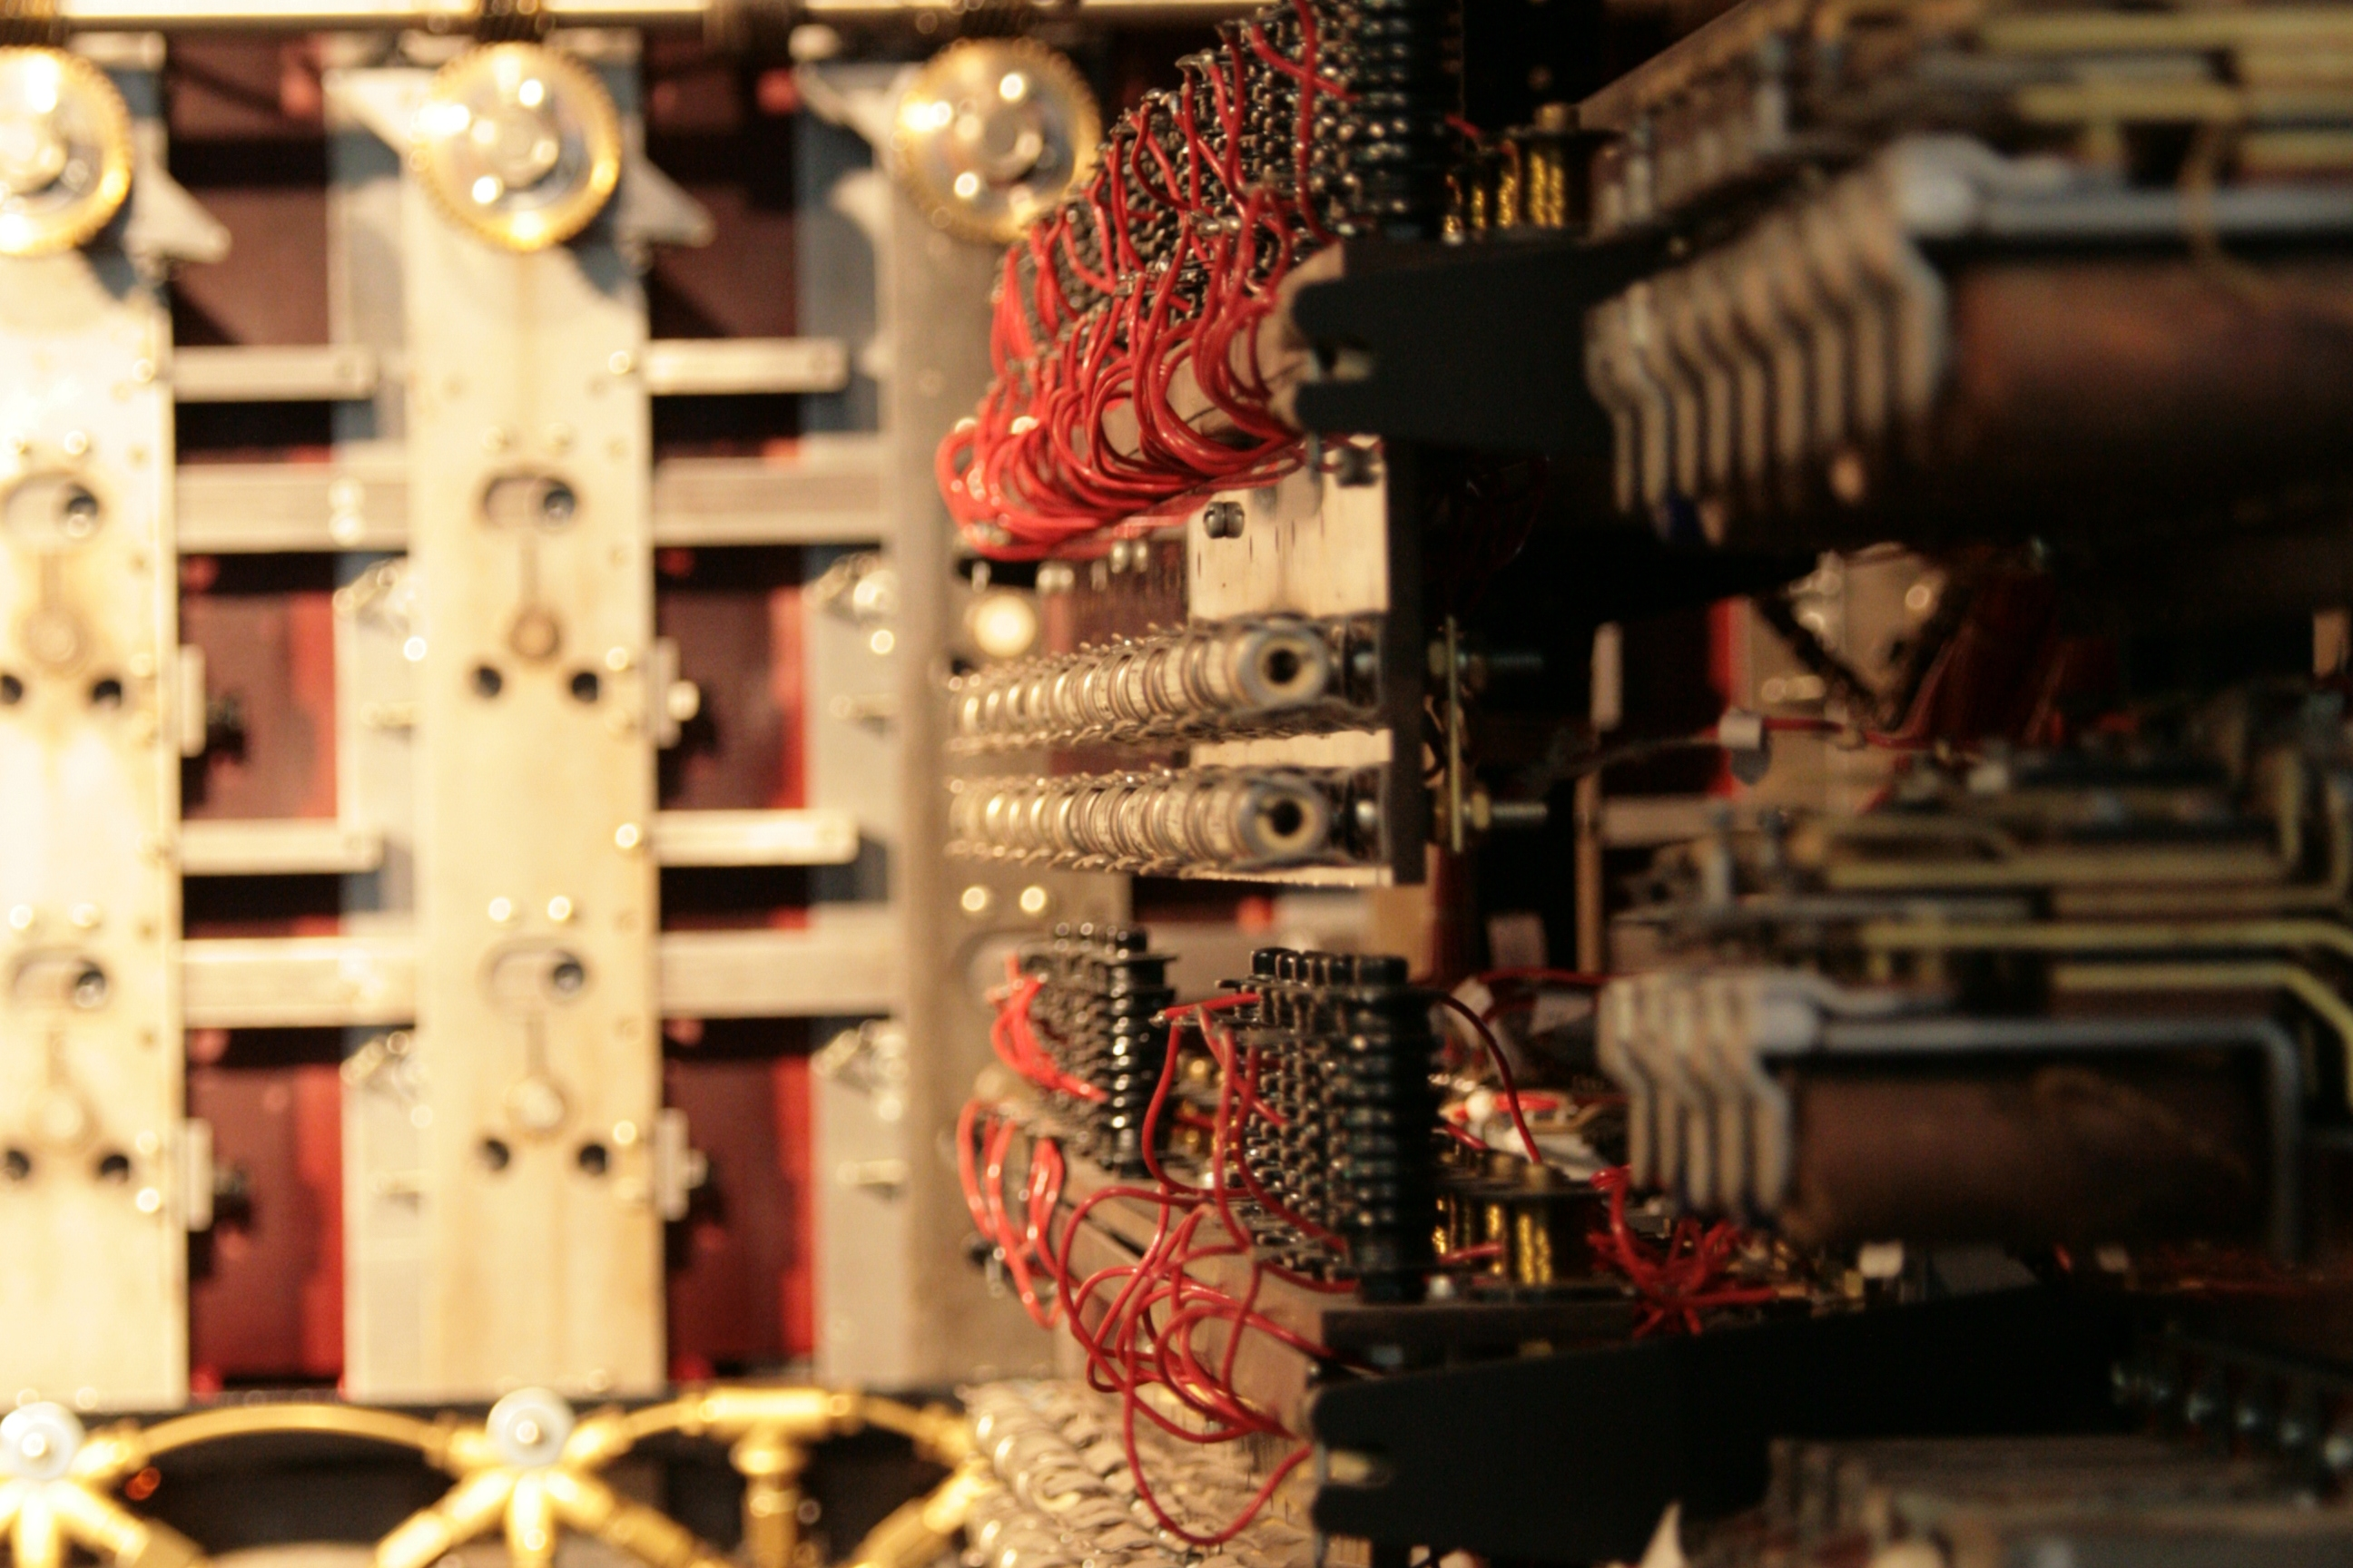

Slide 5
Network Topology
Dual DC^{[1]}
No DC affinity^{[2]}
^{[1]} One more soon(ish)
^{[2]} Well a couple of apps do^{[3]}
^{[3]} We don't talk about them

Slide 6
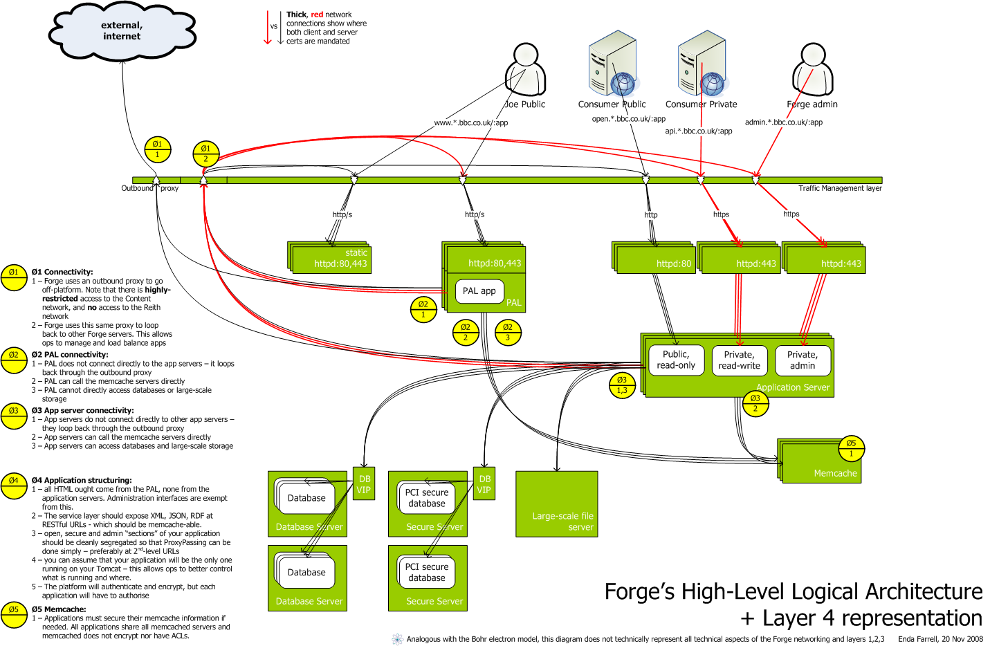
Network Topology

Slide 7
Traffic Routing
ZXTMs -> PAL
ZXTMs -> Varnish -> ZXTMs -> PAL
ZXTMs -> Service Layer
ZXTMs -> Varnish -> ZXTMs -> Service Layer

Slide 8
Traffic Routing
Request
iplayer | \ everything else
et al | \
v \
ZXTM .-> ZXTM .--> ZXTM .--> ZXTM
| / | / | / |
| / | / | / |
v / v / api v / v
Varnish PAL Varnish Dynamite

Slide 9
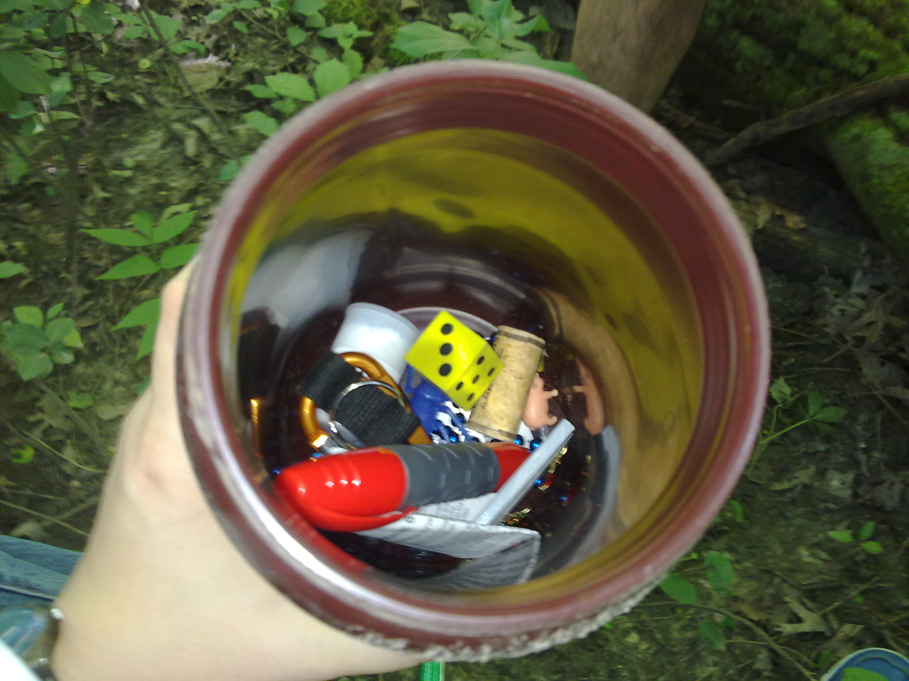

Slide 10
Caching, caching and more caching
mod_cache
Barlesque
Advertising
mod_annotate
Varnish
Cookies

Slide 11
mod_cache & mod_annotate
Request Response <---------MISS----------\
| ^ |
| \-------HIT-------\ |
v | v
Apache --> mod_annotate ---> mod_cache <-> php
/ \
/ \
v v
geo_ip wurfl

Slide 12
Varnish
Custom VCL
Extended with C to provide annotations
Normalise headers
Strip Cookies
Set Cookies
Cache busters
ESI

Slide 13
Annotations to Improve hit/miss ratios
Geo IP data
Device Data - WURFL

Slide 14
Annotations – Normal Client/Server
GET /iplayer/ HTTP/1.1
Host: www.bbc.co.uk
User-Agent: Blah blah blah chuffing fish turnip
Accept: text/html,application/xhtml+xml,application/xml;q=0.9,*/*;q=0.8
Accept-Encoding: gzip, deflate
Accept-Language: en-gb,en;q=0.5
HTTP/1.1 200 OK
Content-Length: 8392
Content-Type: text/html
Cache-Control: max-age=30
Date: Sat, 27 Feb 2012 12:25:00 GMT
Expires: Sat, 27 Feb 2012 12:25:30 GMT

Slide 15
Annotations – Varnish/Server
GET /iplayer/ HTTP/1.1
Host: www.bbc.co.uk
User-Agent: Blah blah blah chuffing fish turnip
X-DEMI-Device: desktop
X-Country: uk
X-Ip_is_uk_combined: yes
X-Ip_is_advertise_combined: no
...
HTTP/1.1 200 OK
Cache-Control: max-age=30
Date: Sat, 27 Feb 2012 12:25:00 GMT
Expires: Sat, 27 Feb 2012 12:25:30 GMT
Vary: X-DEMI-Device, X-Ip_is_uk_combined
...

Slide 16


Slide 17
Pre-existing Monitoring
"SNMP" KPIs to Zenoss
Apache error logs

Slide 18
Monitoring Shortfalls
Granularity
Per app data
In app data
Per service data
Frequency
/me shrugs

Slide 19
Monitoring Solutions
Apache logs
Prototypes

Slide 20
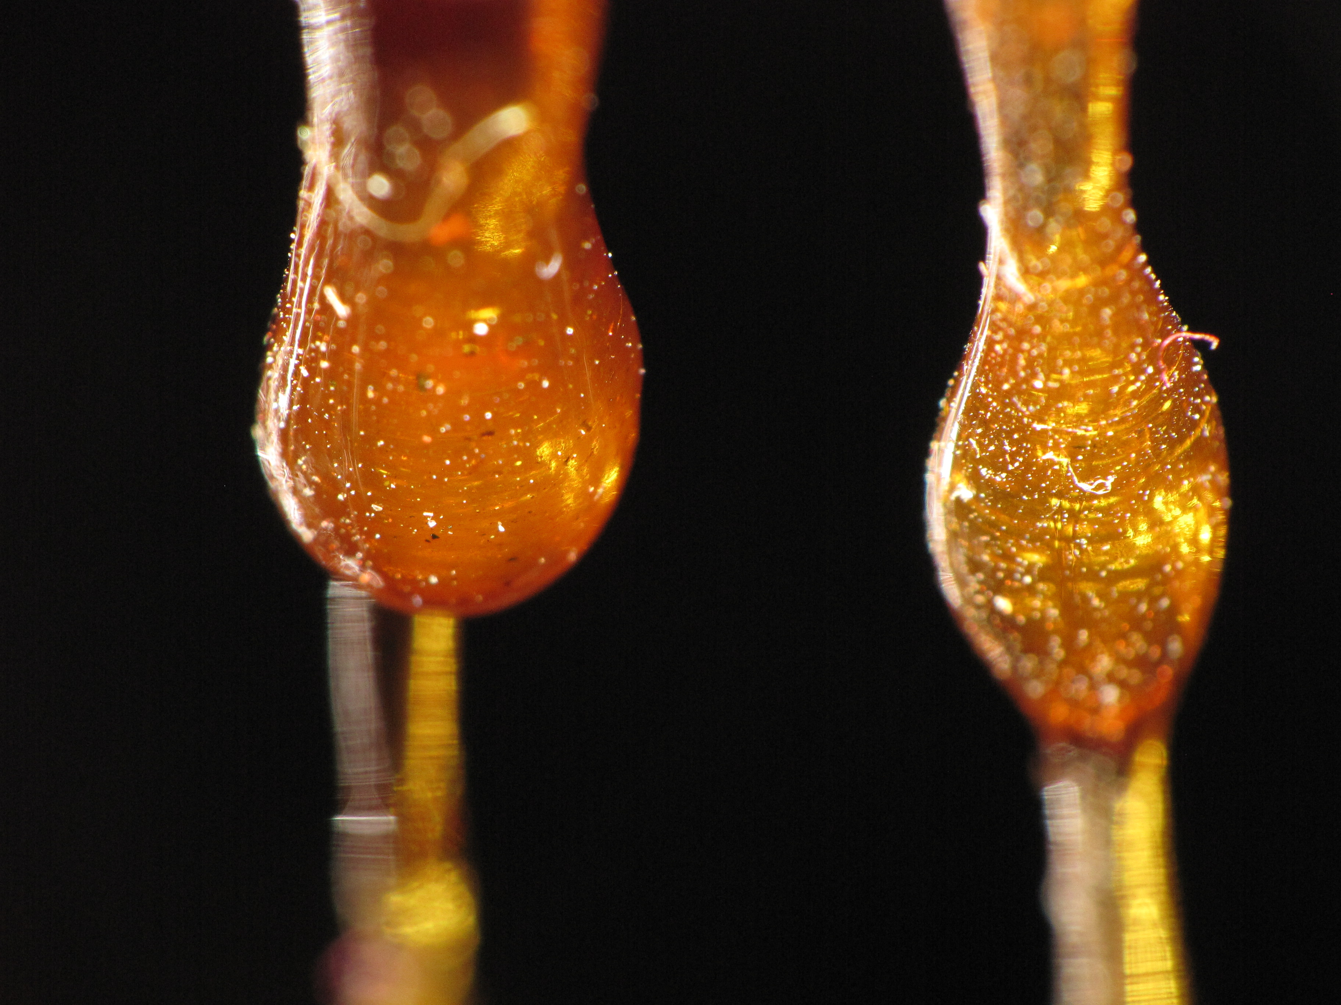

Slide 21
Per Applications Stats for Varnish
Add header response from WebApp
Inline C in VCL
Statsd implementation
Hit/Miss/Pass ratios
Inter-quartile ranges
Updated every 10s

Slide 22
Varnish VCL – Setup
C{
#include <sys/socket.h>
#include <sys/stat.h>
#include <sys/types.h>
#include <sys/un.h>
#include <unistd.h>
#define STATSD_SOCKET "/var/run/statsd/statsd.sock"
#define STATSD_UNCONNECTED -1
#define STATSD_CONNECTING -2
static int statsd_fd_permanent = -1;
static int statsd_fd = STATSD_UNCONNECTED;
static int statsd_get_fd() {
# see next slides
}
static int statsd_increase_cache_counter(…) {
# see next slides
}
static void statsd_close_fd(int fd) {
(void) __sync_val_compare_and_swap(&statsd_fd, fd, STATSD_UNCONNECTED);
}
}C

Slide 23
Varnish VCL – Open Socket
static int statsd_get_fd() {
int fd, i;
struct sockaddr_un addr;
fd = statsd_fd;
if (fd >= 0) { return fd; }
i = __sync_val_compare_and_swap(&statsd_fd, STATSD_UNCONNECTED, STATSD_CONNECTING);
if (i != STATSD_UNCONNECTED) { return i; }
addr.sun_family = AF_UNIX;
strcpy(addr.sun_path, STATSD_SOCKET);
fd = socket(AF_UNIX, SOCK_DGRAM, 0);
i = connect(fd, (struct sockaddr *) &addr, sizeof(addr));
if (i == -1) {
close(fd);
statsd_fd = STATSD_UNCONNECTED;
return -1;
}
if (statsd_fd_permanent == -1) {
statsd_fd_permanent = fd;
} else {
dup2(fd, statsd_fd_permanent);
close(fd);
fd = statsd_fd_permanent;
}
statsd_fd = fd;
return fd;
}

Slide 24
Varnish VCL – Increment Counter
static int
statsd_increase_cache_counter(const char *name, const char *action, const char *reason)
{
int fd, length, i;
char buffer[128];
if (name == NULL) { return 0; }
length = snprintf(
buffer + 1, sizeof(buffer) - 1,
"varnishstats:%s_%s[%s]", name, action, reason
);
if (length < 0 || length >= sizeof(buffer) - 1) { return 0; }
buffer[0] = 1;
fd = statsd_get_fd();
if (fd < 0) { return 0; }
i = send(fd, buffer, 1 + length, 0);
if (i == -1) {
statsd_close_fd(fd);
return 0;
} else {
return 1;
}
}

Slide 25
Varnish VCL – Calling statsd
sub vcl_deliver {
if (resp.http.X-Varnish-Cache-Pass) {
C{
const char *webapp = VRT_GetHdr(sp, HDR_RESP, "\011X-Webapp:");
const char *reason = VRT_GetHdr(sp, HDR_RESP, "\025X-Varnish-Cache-Pass:");
statsd_increase_cache_counter("varnish", "cache", "pass");
statsd_increase_cache_counter("varnish", "pass", reason);
statsd_increase_cache_counter(webapp, "cache", "pass");
statsd_increase_cache_counter(webapp, "pass", reason);
}C
} else {
if (obj.hits > 0) {
/*
* This hit is monitored in vcl_hit because the X-Webapp header is
* lost when a 304 is generated.
*/
} else {
C{
const char *webapp = VRT_GetHdr(sp, HDR_RESP, "\011X-Webapp:");
statsd_increase_cache_counter("varnish", "cache", "miss");
statsd_increase_cache_counter(webapp, "cache", "miss");
}C
}
}
}

Slide 26
Varnish VCL – Calling statsd
sub vcl_hit {
if (obj.cacheable) {
C{
const char *webapp = VRT_GetHdr(sp, HDR_OBJ, "\011X-Webapp:");
// e.g. varnish_cache_hit
statsd_increase_cache_counter("varnish", "cache", "hit");
// e.g. iplayer_cache_hit
statsd_increase_cache_counter(webapp, "cache", "hit");
}C
}
}

Slide 27


Slide 28
Application Performance
Apache logs
XHProf
Sample 1 in x requests
Modified XHProf console
teleportd transport
Data framing

Slide 29
Data transport
Generate profile_id header
teleportd
gzipped data
Add data framing
Maximum socket length
Multiplexed streams

Slide 30
Data framing
Send profile_id plus length of profile data
Use length as framing key
Insert key on newlines
Write as much as we can
Keep writing
Throw away on error

Slide 31
Data framing - PHP
try {
$fp = @fopen($pipe_path, "r+");
} catch (Exception $e) {
error_log("Exception thrown opening pipe $pipe_path:
$e->getMessage()");
}
if ($fp !== false) {
stream_set_blocking($fp, 0);
if(flock($fp, LOCK_EX | LOCK_NB)){
$output = gzencode(json_encode($data));
$size = strlen($output);
$data_to_write = "s" . $size . "\n" . "d" . $size . "|" .
str_replace("\n", "\nd" . $size . "|", $output) . "\n";
if(fwrite_stream($fp, $data_to_write) === false) {
error_log("Error occured while writing to $pipe_path.
fwrite returned false");
}
flock($fp, LOCK_UN);
}
fclose($fp);
} else {
error_log("Unable to open pipe $pipe_path for xhprof data");
}

Slide 32


Slide 33
HAR
HTTP Archive format
teleportd transport
Post data into KV
Possibly CouchDB views

Slide 34
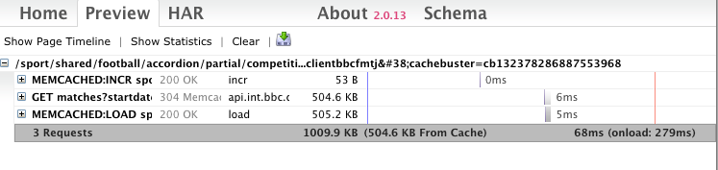
HAR – Http ARchive

Slide 35
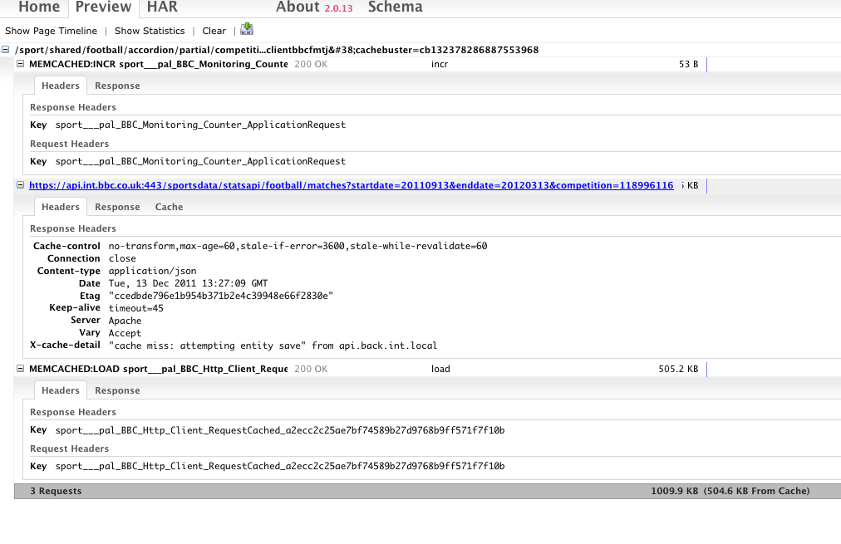
HAR Example

Slide 36
Extending Zend_Http_Client
Already extended as BBC_Http_Client
Handles Client Cert protection
Uses memcache
Added performance information
Use curl handle info where possible

Slide 37
Extending Zend_Cache_Core
Already extended as BBC_Cache_Core
Handles consistent hashing algorithm
Prevents key conflicts
Added performance information
Use microtime
Record record sizes etc.
Can also record APC calls
Not recommended – too many calls

Slide 38


Slide 39
What next?
Pass the profile_id on to service layer
Implement HAR on service layer
Move profile_id to Varnish
Move to ZXTM under discussion
Aggregation interface

Slide 40


Slide 41
Thanks for listening
Thanks to flickr users:
victius
Sportavia Fournier RF4-Redhawks Display Team-Duxford Oct 2010
http://www.flickr.com/photos/victius/5184316825
dgjones
Office Dalek, London, 14-10-06
http://www.flickr.com/photos/dgjones/284592369
b3cft
Bombe rebuild detail
http://www.flickr.com/photos/b3cft/3797123899
eszter
Cache contents
http://www.flickr.com/photos/eszter/3851576235
Enjoy Surveillance
What are you looking at?
http://www.flickr.com/photos/enjoy-surveillance/34795807/
TaranRampersad
Varnish (1)
http://www.flickr.com/photos/knowprose/4862298148/
Solo
45th Annual Watsonville Fly-in and Air Show
http://www.flickr.com/photos/donsolo/4959045491/in/photostream/
SF Brit
Sunset over Iguazu
http://www.flickr.com/photos/cnbattson/4333692253/

Slide 42
Thanks for listening
This presentation:
github.com/b3cft/PHP-London-2012-Talk
Me:
Andy “Bob” Brockhurst
Twitter: b3cft (and pretty much anywhere online)
www.kingkludge.net
http://joind.in/4964

Slide 43


